Slide 1
Case Study
The NextGen POS System
Chapter 3
Applying UML and Patterns
Craig Larman

Slide 2
The Case Study
The text uses the development of a Point of Sale (POS) System as a case study to demonstrate object oriented software development.
A POS system is a replacement for a cash register that adds many computer services to the traditional cash register. Most retail stores now use POS systems.

Slide 3
What is POST
A point-of-sale terminal (POST) system is a computerized system used to record sales and handle payments.
It is typically used in a retail store.
It includes hardware components, i.e., a computer, a bar code scanner and software to run the system.
This case study demonstrates an iterative incremental process, covering the analysis and design phases.

Slide 4
Important Features
A POS system increasingly must support multiple and varied client-side terminals and interfaces.
  These include a thin-client Web browser terminal, a regular personal computer with something like a Java Swing graphical user interface, touch screen input, wireless PDAs, and so forth.
This commercial POS system that we will sell to different clients with disparate needs in terms of business rule processing.
  Each client will desire a unique set of logic to execute at certain predictable points in scenarios of using the system, such as when a new sale is initiated or when a new line item is added.
Therefore, we will need a mechanism to provide this flexibility and customization.

Slide 5
Architectural Layers
User Interface
  (minor topic)
Application Logic and Domain Objects
  Sale and Payment (main topics)
Technical Services
  Log and Persistence (secondary topics)

Slide 6
Iterative Learning/Development
The text is organized in three iterations.
Each iteration will deliver a product to the customer, with subsequent iterations adding features to the earlier ones.
Each iteration will do analysis and design only on the features for the current release of the software.

Slide 7
Use Case Scenario
Informally then, a use case is a collection of related success and failure scenarios that describe an actor using a system to support a goal. For example, here is a casual format use case with alternate scenarios:
Handle Returns
Main Success Scenario: A customer arrives at a checkout with items to return. The cashier uses the POS system to record each returned item …
Alternate Scenarios:
If the customer paid by credit, and the reimbursement transaction to their credit account is rejected, inform the customer and pay them with cash.
If the item identifier is not found in the system, notify the Cashier and suggest manual entry of the identifier code (perhaps it is corrupted).
If the system detects failure to communicate with the external accounting system, …

Slide 8
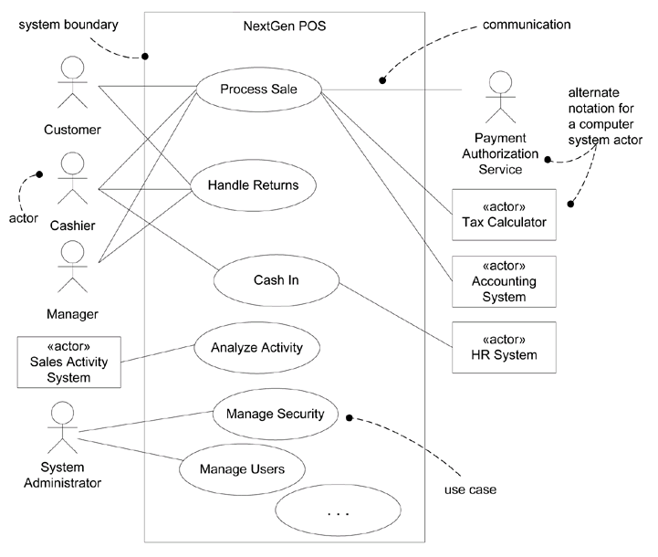
Use Case Diagram for specifying functional requirements

Slide 9
Use Case UC1: Process Sale
Scope: NextGen POS application
Level: user goal
Primary Actor: Cashier
Stakeholders and Interests:
  Cashier: Wants accurate, fast entry, and no payment errors, as cash drawer shortages are deducted from his/her salary
  Salesperson: Wants sales commissions updated
  Customer: Wants purchase and fast service with minimal effort. Wants easily visible display of entered items and prices. Wants proof of purchase to support returns.
  Company: Wants to accurately record transactions and satisfy customer interests. Wants to ensure that Payment Authorization Service payment receivables are recorded. Wants some fault tolerance to allow sales capture even if server components (e.g., remote credit validation) are unavailable. Wants automatic and fast update of accounting and inventory.
  Manager: Wants to be able to quickly perform override operations, and easily debug Cashier problems.
  Government Tax Agencies: Want to collect tax from every sale. May be multiple agencies, such as national, state, and county.
  Payment Authorization Service: Wants to receive digital authorization requests in the correct format and protocol. Wants to accurately account for their payables to the store.

Slide 10
Preconditions: Cashier is identified and authenticated.
Success Guarantee (or Postconditions): Sale is saved. Tax is correctly calculated. Accounting and inventory are updated. Commissions recorded. Receipt is generated. Payment authorization approvals are recorded.

Slide 11
Main Success Scenario:
  Customer arrives at POS checkout with goods and/or services to purchase.
  Cashier starts a new sale
  Cashier enters item identifier.
  System records sale line item and presents item description, price, and running total. Price calculated from a set of price rules.
  Cashier repeats steps 3-4 until indicates done.
  System presents total with taxes calculated.
  Cashier tells Customer the total, and asks for payment.
  Customer pays and System handles payment.
  System logs completed sale and sends sale and pyment information to the external Accounting system (for accounting and commissions) and Inventory system (to update inventory).
  System presents receipt.
  Customer leaves with receipt and goods (if any).

Slide 12
Extension:
A. At any time, Manager requests an override operation:
  System enters Manager-autorized mode.
  Manager or Cashier performs one Manager-mode operation. E.g. cash balance change, resume a suspended sale on another register, void a sale, etc.
  System reverts to Cashier-authorized mode.
B. At any time, System fails:
To support revocery and correct accounting, ensure all transaction sensitive state and events can be recovered from any step of the scenario.
  Cashier restarts System, logs in, and requests recovery of prior state.
  System reconstructs prior state.
    2a. System detects anomalies preventing recovery:
    System signals error to the cashier, records the error, and enters a clean state.
    Cashier starts a new sale.

Slide 13
Other Requirements
The Supplementary Specification captures and identifies other kinds of requirements, such as reports, documentation, packaging, supportability, licensing, and so forth.
The Glossary captures terms and definitions; it can also play the role of a data dictionary.
The Vision summarizes the "vision" of the projectan executive summary. It serves to tersely communicate the big ideas.
The Business Rules (or Domain Rules) capture long-living and spanning rules or policies, such as tax laws, that transcend one particular application.

